Slide 1
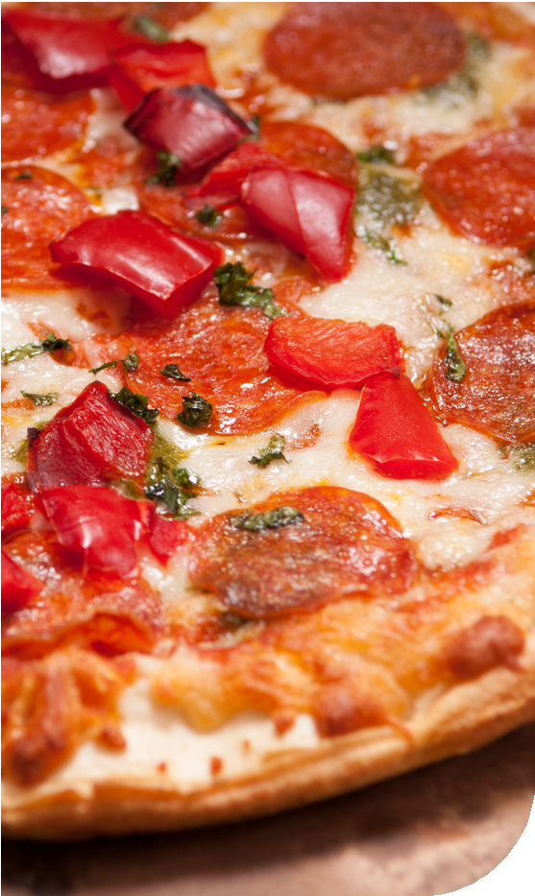


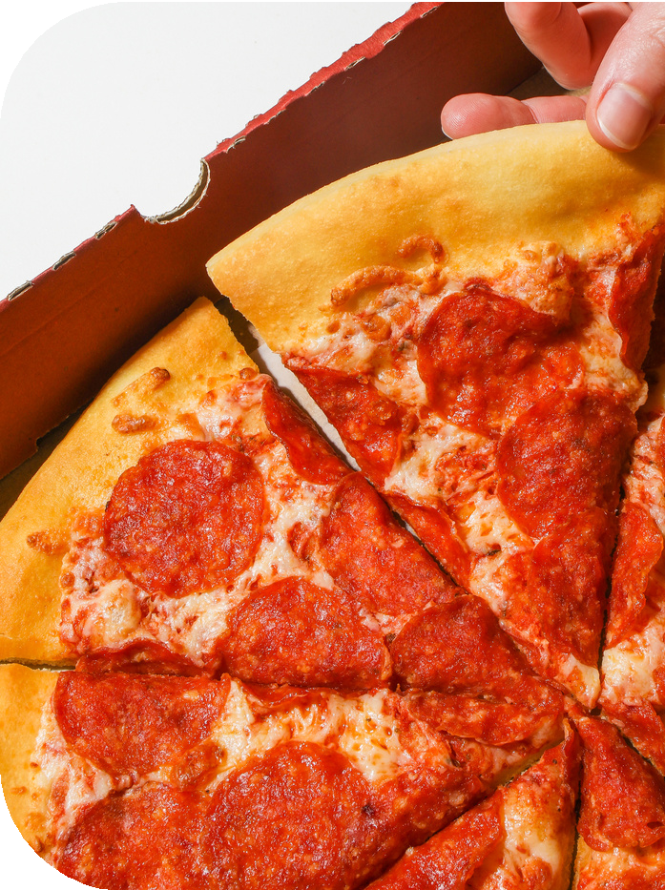


TITLE
Pizza Sales Analysis
End-to-End SQL Project
Prepared : Abhishek Chouhan
Role : Data Analyst / SQL Analyst
Tools Used : SQL , Excel , PowerPoint

Slide 2

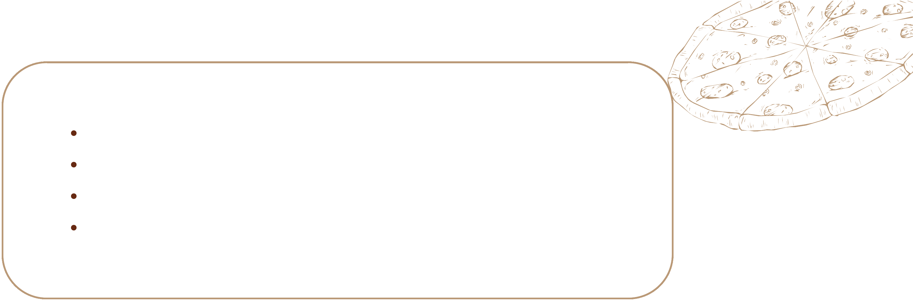
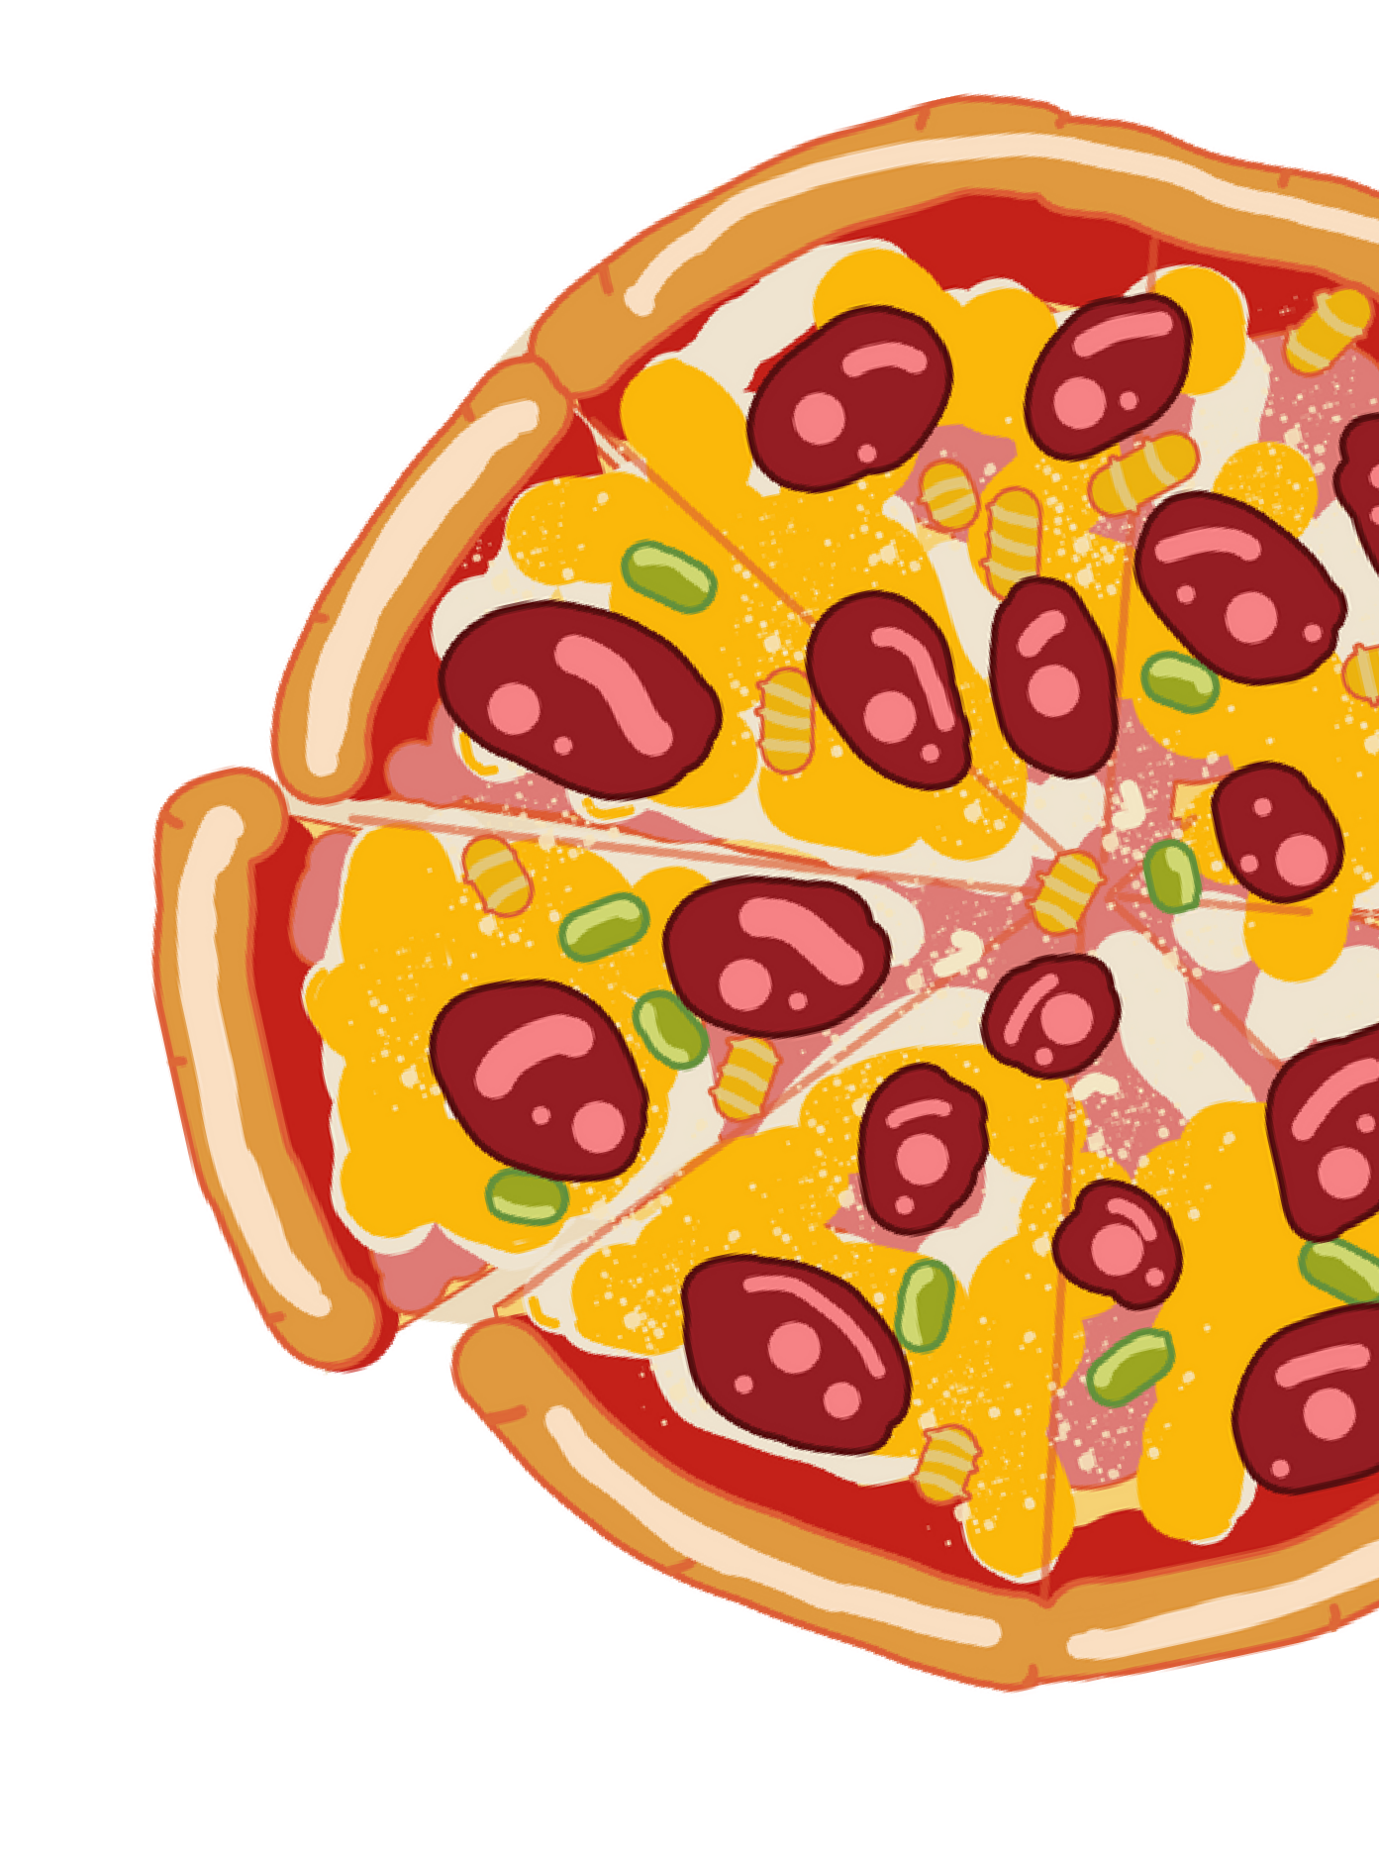

BUSINESS PROBLEM
Despite having sales data available, the business does not have clear visibility into:
Overall sales and revenue performance
Best-selling and least-selling pizzas
Customer preferences by pizza category and size
Peak order times and high-revenue days
Product contribution to total revenue
Due to the absence of analytical insights, business decisions related to pricing, promotions, inventory planning, and menu optimization are made without data-backed evidence, resulting in missed revenue and growth opportunities.

Slide 3
PROJECT OBJECTIVE
The objective of this project is to analyze pizza sales data using SQL to:
Analyze pizza sales data using SQL
Identify key performance indicators (KPIs)
Understand customer ordering behavior
Evaluate pizza category, size, and product performance
Provide actionable insights and business recommendations
Generate actionable insights to improve business profitability and operational efficiency

Slide 4
The analysis is based on four relational tables:
DATASET OVERVIEW
Orders: Order date and time information
Order_Details: Pizza quantity per order
Pizzas: Pizza size and price
Pizza_Types: Pizza name and category
These tables are joined using primary and foreign keys to perform detailed sales analysis.

Slide 5
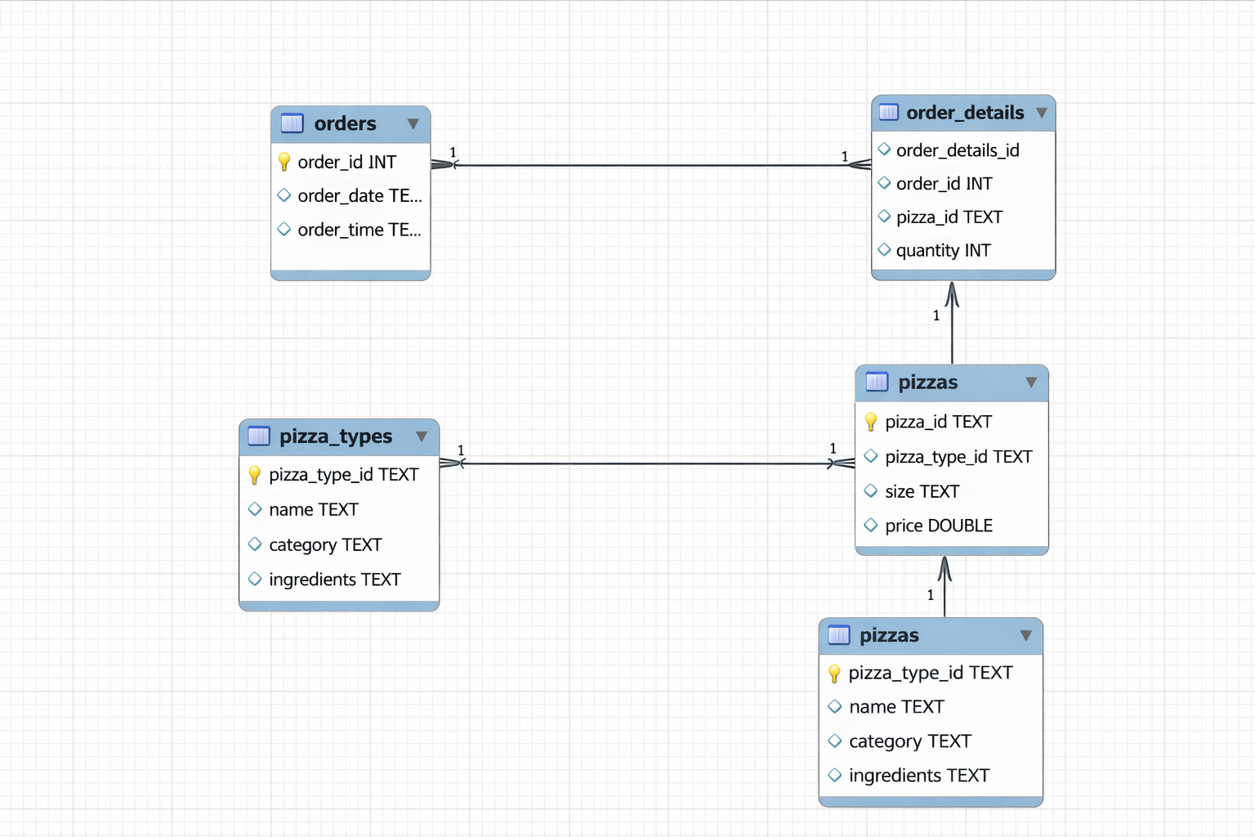

DATA MODEL & ER DIAGRAM
One order can contain multiple pizza items
Revenue is calculated as Quantity × Price
This data model enables accurate order-level and product-level analysis.
Relationships:
Orders → Order_Details
Order_Details → Pizzas
Pizzas → Pizza_Types

Slide 6


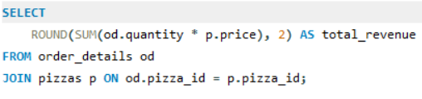
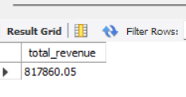


Q1 - What is the total revenue generated?
Insight: The business generated a total revenue of ₹817,860.05 from pizza sales during the analyzed period.

Slide 7


Q2 - How many total orders were placed?
Insight:
A total of 21,350 distinct customer
orders were placed during
the analyzed period.

Slide 8


Q3 - How many pizzas were sold in total?
Insight:
A total of 49,574 pizzas were sold
during the analyzed period.

Slide 9
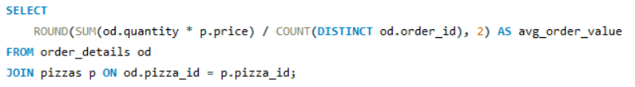

Q4 - What is the average revenue per order?
Insight:
The average order value is ₹38.31,
indicating the typical revenue generated
per customer order.

Slide 10


Q5 - On average, how many pizzas are ordered per order?
Insight:
On average, customers order 2.32
pizzas per transaction.

Slide 11
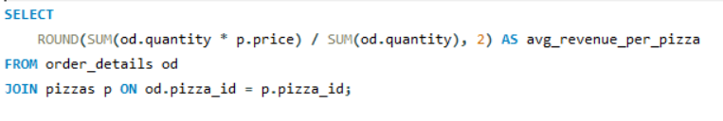

Q6 - What is the average revenue per pizza sold?
Insight:
Each pizza generates an average
revenue of ₹16.50.

Slide 12


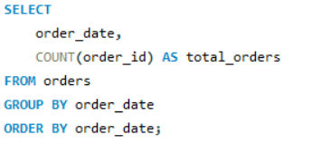
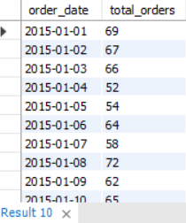
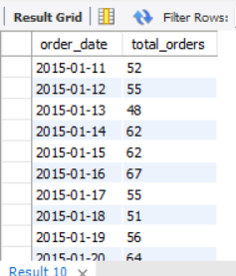


Q7 - How many orders are placed each day?
Insight :
Order volume is not consistent day-to-day, highlighting periods of higher and lower customer activity.

Slide 13
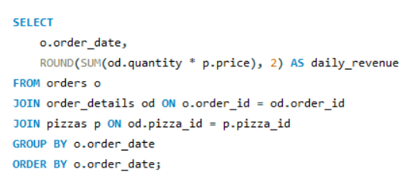
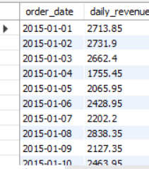
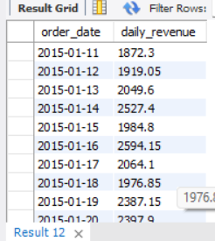
Q8 - How does revenue trend over time?
Insight :
Daily revenue trends show variability, suggesting certain days generate higher value orders than others.

Slide 14
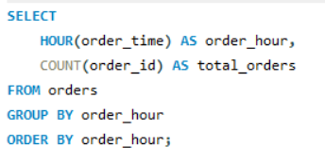
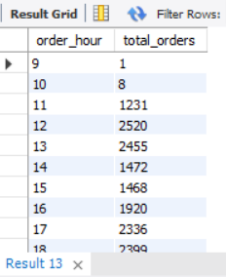
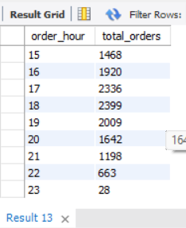
Q9 - At what time of day are most orders placed?
Insight :
Order volume peaks during lunch and evening hours, indicating clear meal-time demand patterns.

Slide 15
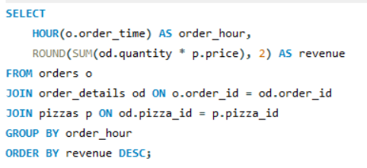
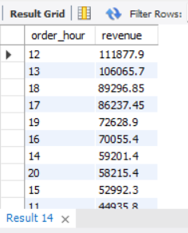
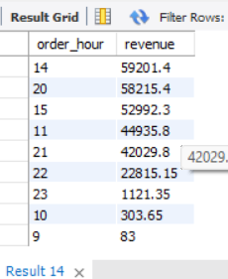
Q10 - Which time slots generate the highest revenue?
Insight :
Revenue peaks during lunch (12–1 PM) and dinner (6–8 PM) hours, reflecting higher-value customer purchases during meal times.

Slide 16
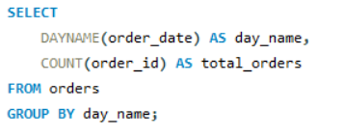
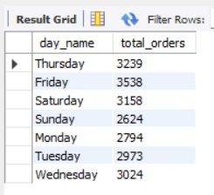
Q11 - Which days have the highest order volume?
Insight :
Order volume is highest on Fridays and Saturdays, indicating increased demand toward the weekend.

Slide 17
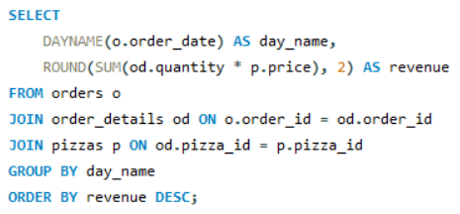
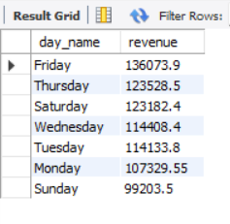
Q12 - Which days have the highest order volume?
Insight :
Friday generates the highest revenue, indicating strong customer spending toward the end of the week.

Slide 18


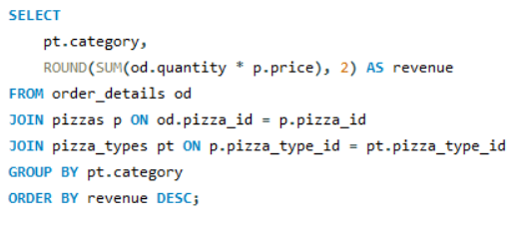
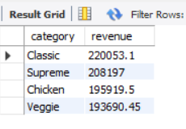


Q13 - Which category contributes the most revenue?
Insight :
The Classic category generates the highest revenue, making it the primary revenue driver for the business.

Slide 19
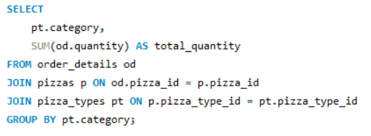
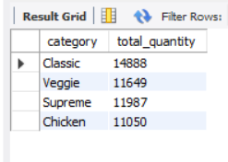
Q14 - Which category sells the most pizzas?
Insight :
Classic pizzas have the highest sales volume, making them the most frequently ordered category.

Slide 20
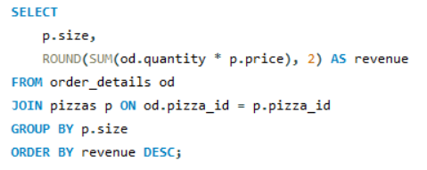
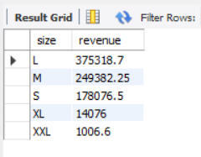
Q15 - Which pizza size generates maximum revenue?
Insight :
Large (L) pizzas generate the highest revenue, making them the most valuable size for the business.

Slide 21
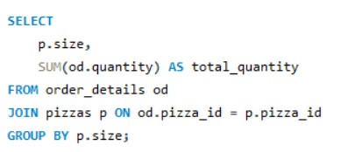
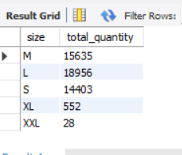
Q16 - Which pizza size is most preferred by customers?
Insight :
Medium and Large pizzas account for the highest sales volume, indicating strong customer preference for these sizes.

Slide 22
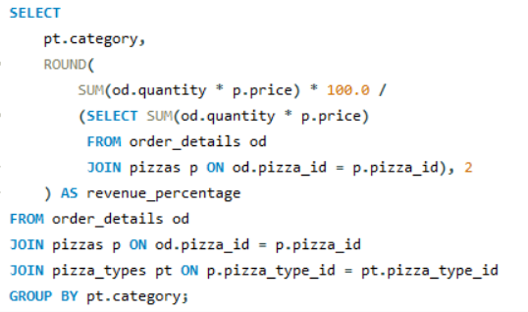
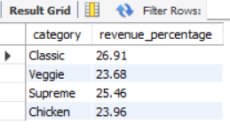
Q17 - What % of total revenue comes from each category?
Insight :
The Classic category contributes the highest share of total revenue (26.91%), making it the strongest revenue contributor.

Slide 23
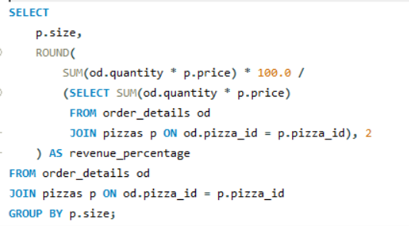
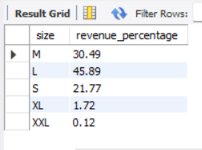
Q18 - What % of revenue comes from each pizza size?
Insight :
Large pizzas contribute nearly half of total revenue (45.89%), making them the most critical size for business growth.

Slide 24

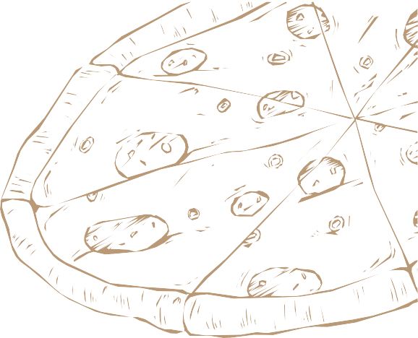
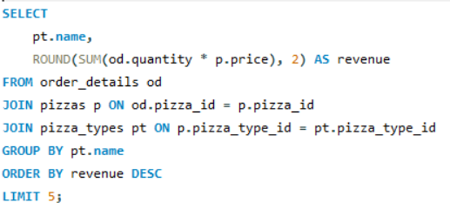
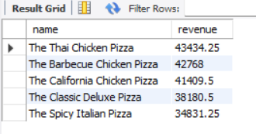


Q19 - Which pizzas generate the highest revenue?
Insight :
The Thai Chicken Pizza and Barbecue Chicken Pizza are the top revenue-generating products, leading overall sales performance.

Slide 25
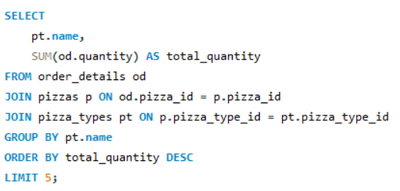
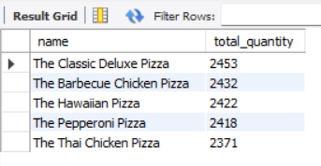
Q20 - Which pizzas are ordered the most?
Insight :
The Classic Deluxe Pizza is the most frequently ordered item, indicating strong and consistent customer demand.

Slide 26
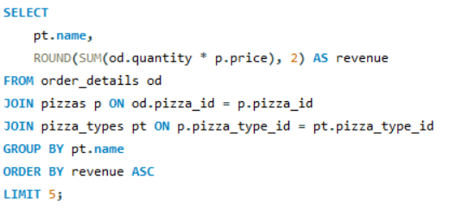
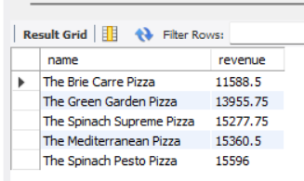
Q21 -Which pizzas under perform in revenue?
Insight :
These pizzas generate the lowest revenue, indicating weak customer demand and limited sales contribution.

Slide 27
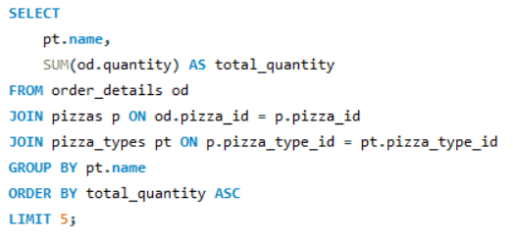
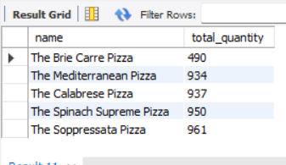
Q22 -Which pizzas sell the least?
Insight :
These pizzas have the lowest sales volume, indicating limited customer demand and low popularity.

Slide 28
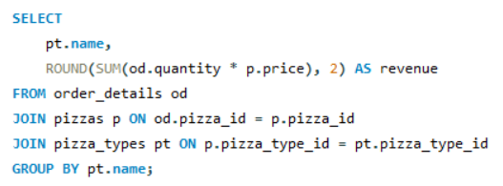
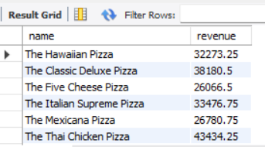
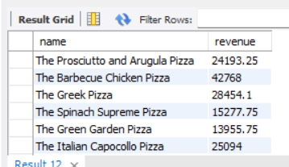
Q23 -How much revenue does each pizza generate?
Insight :
Revenue is unevenly distributed across pizzas, with a few products generating significantly higher revenue than others.

Slide 29
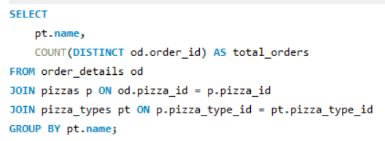


Q24 -How frequently is each pizza ordered?
Insight :
Classic Deluxe and Barbecue Chicken pizzas receive the highest number of orders, making them the most popular choices among customers.

Slide 30






Q25 - Which pizzas contribute most to total revenue?
Insight :
The Thai Chicken Pizza ranks #1 in revenue, followed by Barbecue Chicken and California Chicken pizzas.

Slide 31


Q26 -Do few pizzas drive most revenue ?
Insight :
Classic pizzas rank #1 in revenue, followed by Supreme, while Veggie ranks lowest among all categories.

Slide 32


Q27 -Do few pizzas drive most revenue (Pareto)?
Insight :
A small group of pizzas, led by Thai Chicken and Barbecue Chicken, generates the highest revenue, indicating strong product concentration.

Slide 33


Q28 -Which categories perform best overall?
Insight :
During peak evening hours (6–9 PM), \Classic pizzas are the most ordered category, indicating strong dinner-time preference.

Slide 34


Q29 - Which orders generate above-average revenue?
Insight :
Several orders exceed the average order value, indicating the presence of high-value customers and larger basket sizes.

Slide 35




BUSINESS RECOMMENDATIONS
Focus Promotions on Peak Hours:
Lunch (12–1 PM) and Dinner (6–8 PM) generate the highest revenue.
Run time-based discounts, combo offers, and digital ads during these hours to maximize sales.
2. Promote Classic Category as a Core Offering:
Classic pizzas contribute the highest revenue and volume.
Maintain strong visibility, menu placement, and stock availability for Classic pizzas.
3. Upsell Medium & Large Sizes :
Medium and Large sizes dominate both quantity and revenue.
Introduce upgrade prompts (e.g., “Upgrade to Large for ₹X more”) to increase order value.
4. Increase Average Order Value (AOV) :
Average order value is moderate, indicating upselling potential.
Bundle pizzas with drinks, sides, or desserts to increase basket size.
5. Align Staffing with Demand Patterns :
Order and revenue volumes vary by hour and day.
Schedule more staff during peak hours and high-order days to improve service speed and customer experience.
6. Use Data-Driven Seasonal Campaigns :
Daily order trends show variability.
Design weekday offers, weekend combos, and festival specials based on demand patterns

Slide 36
CONCLUSION
This analysis reflects how a real pizza business operates on a daily basis, where customer demand, meal timing, and product preference directly impact revenue. The findings show that most customers place orders during lunch and dinner hours, prefer Medium and Large pizzas, and consistently choose a small set of popular pizza varieties.
From a business perspective, this means revenue growth does not come from selling everything equally, but from focusing on what customers already prefer. By prioritizing high-demand pizzas, optimizing staffing during peak hours, and encouraging customers to increase order size through combos and upselling, the business can improve profitability without increasing operational complexity.
Overall, this project demonstrates how everyday sales data can be transformed into practical insights that help a restaurant improve customer experience, reduce waste, and make smarter, data-driven decisions in real-world operations.

